Slide 1
Evolution of Microprocessor
DIVYA SINGH
Assistant Professor

Slide 2
Evolution of Microprocessor
The Mechanical Age
The Electrical Age
The Electronic Age
The Microprocessor Age

Slide 3
Mechanical Age of Microprocessor
Abacus : invented by Babylonians
The First Mechanical Calculator
Improved By Blaise Pascal in 1642
Invented a calculator that was constructed of gears and wheels.
Example: Automobile’s odometer

Slide 4
Mechanical Age of Microprocessor
The First practical geared mechanical machine :Used to Compute information dates was designed in early 1800.
Charles Babbage :The first computing machinery to perform multistep operations automatically.
First computing machine :Difference engine
It was intended to compute and print mathematical tables automatically.
Only perform addition operation

Slide 5
The Electrical Age of Microprocessor
Electric Motors :To drive the mechanical components, thus making calculator electromechanical.
It greatly increasing their speed.
Blaise pascal and Bomer :introduced small hand-held electronic calculator
It was in well use until the early 1970.

Slide 6
The Electronic Age of Microprocessor
Use 18000 vacuum tubes and 1500 relays.
Constructed under the direction of Ekert and Mauchly at the Moore school.
It was able to perform 5000 addition and subtractions per second.
The first electronic computer : ENIAC : Electronic Numerical Integrator and Computer
John Von Neumann : gives first stored program concept.
Give new name to ENIAC : EDVAC- Electronic discrete variable computer.
It facilitated users to enter and alter various programs and do variety of computations.

Slide 7
Microprocessor Age of Microprocessor
Use Silicon chip(Micro chip).
Use Five units based on John Von Neumann concept.
Word Size for define abilities of Microprocessor.
Journey Start from 1971.
Intel coined the term ‘MICROPROCESSOR’ and in 1971 released the first 4-bit microprocessor as the 4004 having 2300 transistors,640 bytes of memory addressing capacity and a 108 kHz clock speed.

Slide 8
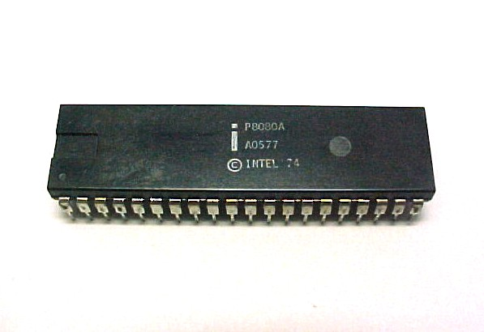
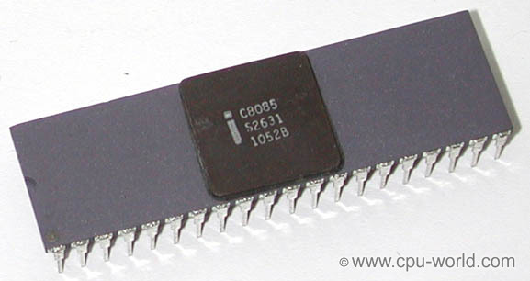
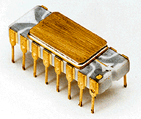
Microprocessor Age of Microprocessor
4004
8080
8085

Slide 9
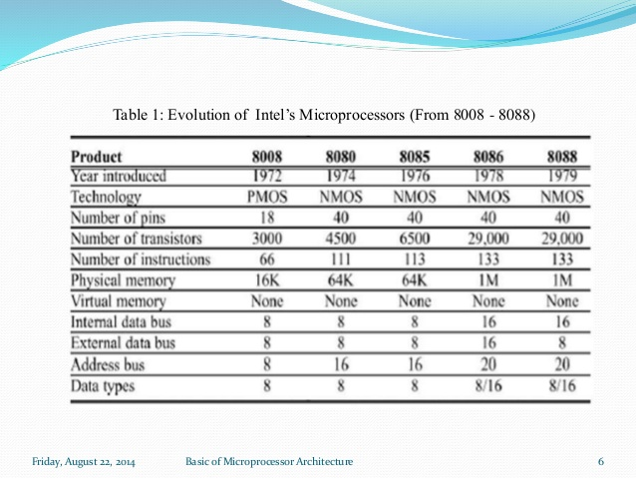
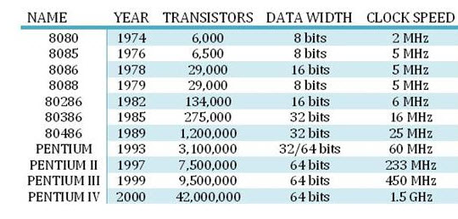
Microprocessor Age(1974-1979)

Slide 10
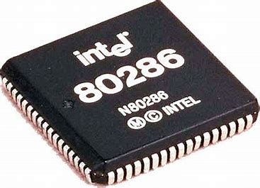
Microprocessor 80186,80286,80386 & 80486
Few additional instructions are added. The new instructions include PUSHA, POPA, INS, OUTS, BOUND, ENTER, LEAVE, and immediate multiplication and shift/rotate counts.
include a clock generator, a programmable interrupt controller, three programmable timers, a programmable DMA controller.
80386 First 32 bit microprocessor.(1985)
Clock speed 16-33 MHz.
Address up to 4 GB memory
Concept of paging(Virtual Memory).

Slide 11
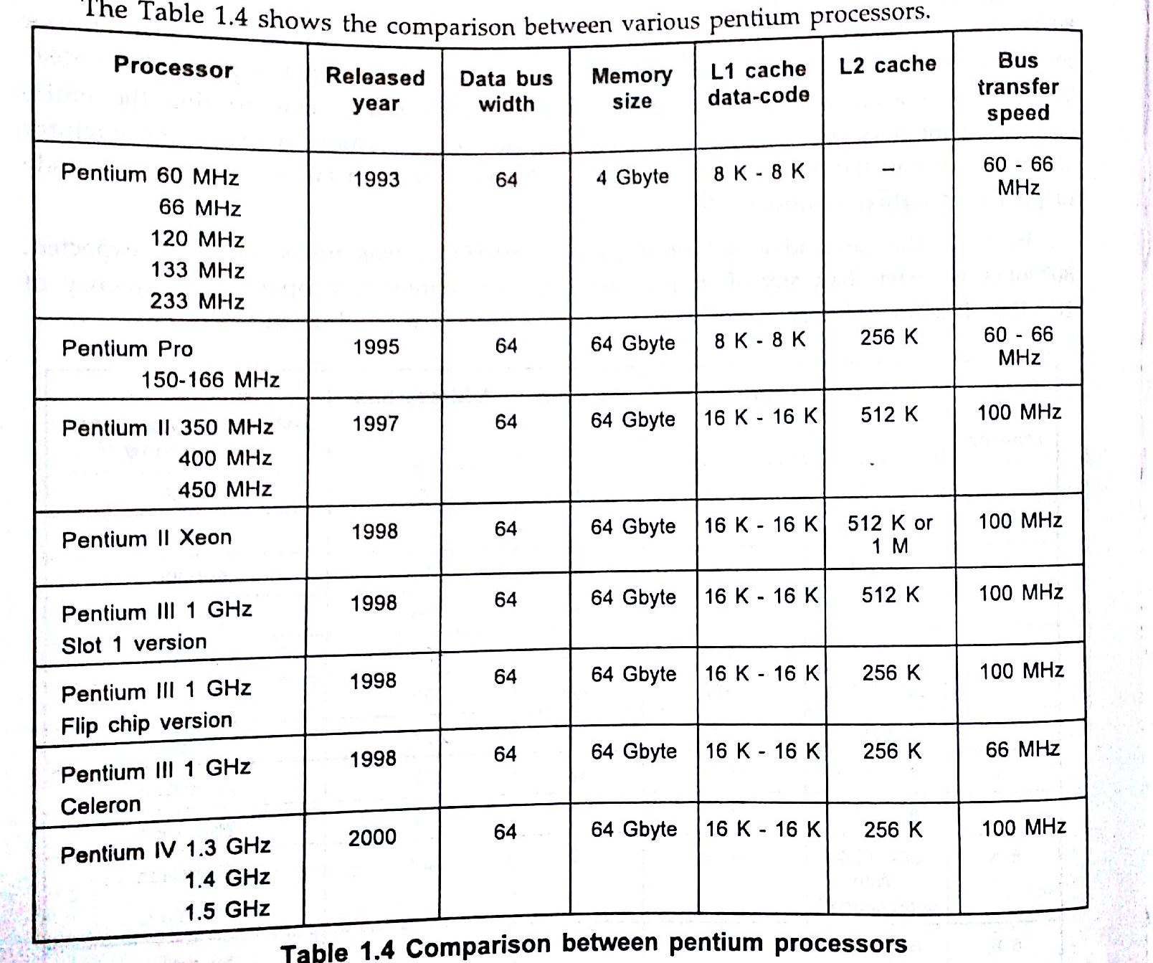

Slide 12

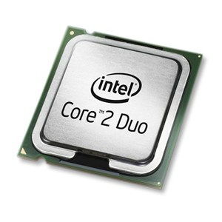
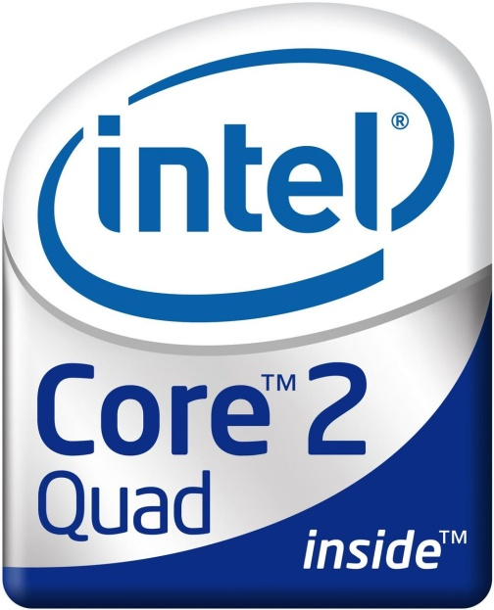
2007, Intel released the desktop Pentium Dual-Core branded processors known as the Pentium E2140 and E2160. An E2180 model was released later in September 2007.
Core 2 is a brand encompassing a range of Intel's consumer 64-bit x86-64 single-, dual-, and quad-core microprocessors based on the Core microarchitecture. The single- and dual-core models are single-die, whereas the quad-core models comprise two dies, each containing two cores, packaged in a multi-chip module.

Slide 13
